Slide 1


Avoiding Reserves Quicksand
… brought to you by
www.ReserveStudy.com
www.reservestudy.com

Slide 2

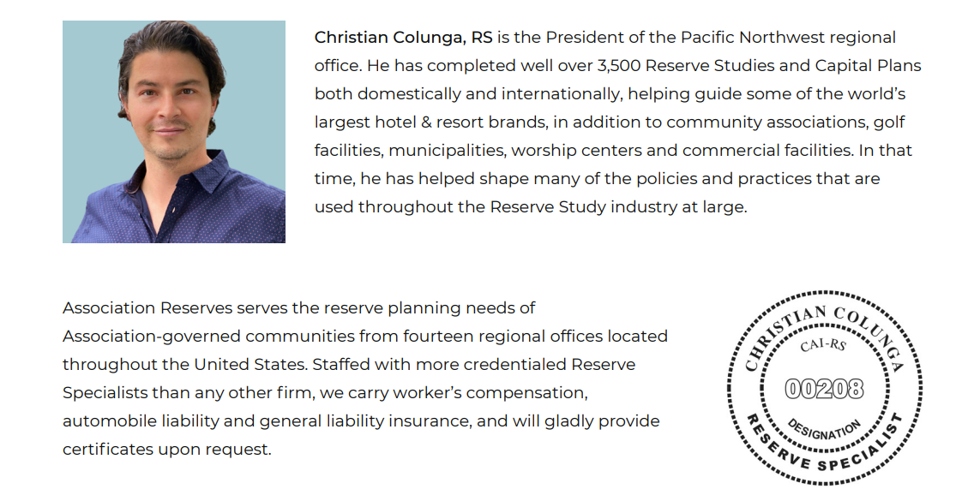

Slide 3

Avoiding Reserves Quicksand
Introduction
Identifying Quicksand
Getting out of Quicksand
Avoiding Quicksand
Summary
www.reservestudy.com

Slide 4

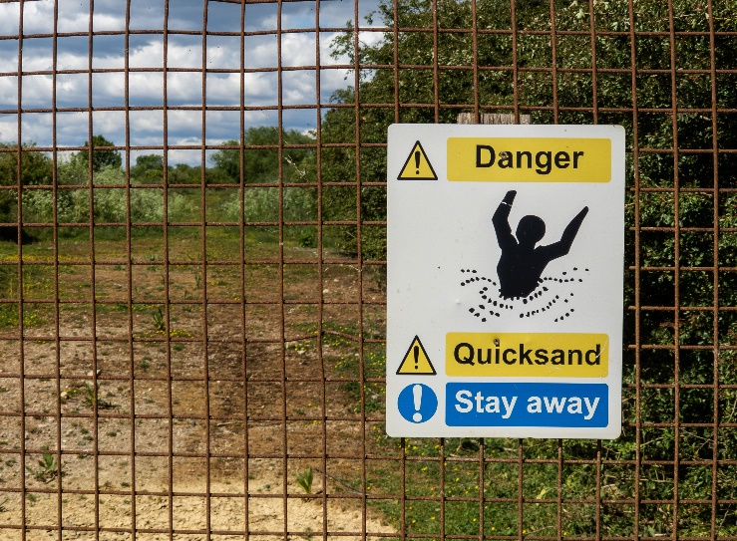
Introduction
It’s a journey to the future, and there’s trouble along the way.
www.reservestudy.com

Slide 5


Introduction
Nothing you can do to stop them, those big expenses are lurking, and they can easily scare you “off the trail”!
www.reservestudy.com

Slide 6
Introduction
The board has the job of leading the association safely to the future. Will you get there safely, or get stuck along the way?
www.reservestudy.com

Slide 7

Introduction
What does success look like?
Sufficient Reserves to perform projects on time
(no deferred maintenance, no special assessments)
Maximized property values
www.reservestudy.com

Slide 8
Avoiding Reserves Quicksand
Introduction
Identifying Quicksand
Getting out of Quicksand
Avoiding Quicksand
Summary
www.reservestudy.com

Slide 9
Identifying Quicksand
Types of Quicksand:
Hoarding Reserves
Depleting Reserves
Not collecting/preparing
Apathy
Unsure when to spend Reserves
Fixating on Percent Funded
Indecision!
www.reservestudy.com

Slide 10
Avoiding Reserves Quicksand
Introduction
Identifying Quicksand
Getting out of Quicksand
Avoiding Quicksand
Summary
www.reservestudy.com

Slide 11
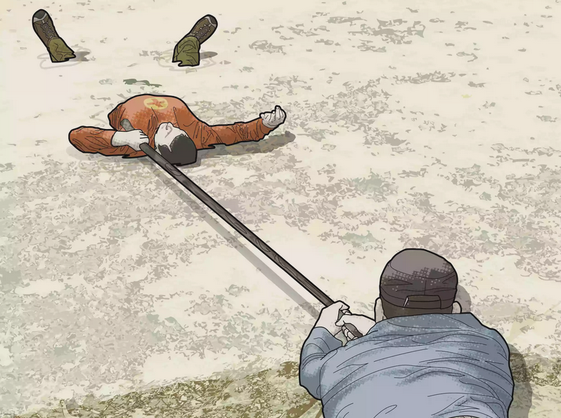
Getting out of Quicksand
Get Help!
Experienced Manager
Credentialed Reserve Study Professional
www.reservestudy.com

Slide 12

Getting out of Quicksand
The Business Judgment Rule
Duty of Care
Duty of Loyalty
Duty of Inquiry
www.reservestudy.com

Slide 13
Getting out of Quicksand
The Business Judgment Rule
Duty of Care
Duty of Loyalty
Duty of Inquiry
Find out what to do financially (get fresh information in an updated Reserve Study)
www.reservestudy.com

Slide 14
Getting out of Quicksand
The Business Judgment Rule
Duty of Care
Duty of Loyalty
Duty of Inquiry
Then take action
www.reservestudy.com

Slide 15
Avoiding Reserves Quicksand
Introduction
Identifying Quicksand
Getting out of Quicksand
Avoiding Quicksand
Summary
www.reservestudy.com

Slide 16

Avoiding Quicksand
It’s all about sustainability
Make contributions that offset deterioration
www.reservestudy.com

Slide 17

Avoiding Quicksand
Rely on trusted guides!
Experienced Manager
Credentialed Reserve Study Professional
www.reservestudy.com

Slide 18

Avoiding Quicksand
Update your Reserve Study Regularly (to identify “where you are” and “where to go from here”)
www.reservestudy.com

Slide 19
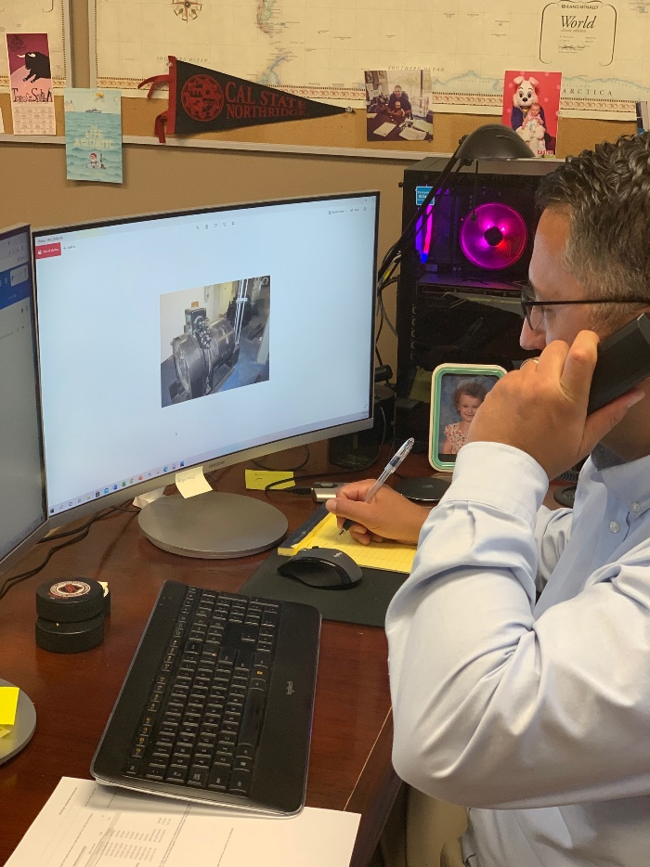
Avoiding Quicksand
Reach out to your Manager or Reserve Study professional with periodic questions
www.reservestudy.com

Slide 20
Summary
The quicksand is out there.
You’re on the journey. You don’t have a choice about it.
You’re not on your own.
There are landmarks along the way
Just keep your eyes open, look around, follow your guide(s) and you’ll be just fine!
www.reservestudy.com

Slide 21

Additional Resources at
www.ReserveStudy.com
www.reservestudy.com

