Slide 1

AHFC Property Management Portal Webinar
Thursday, January 18, 2024

Slide 2
Property Management Portal Webinar Outline
1
Login to the AHFC Portal
2
Home Screen : Select your Property
3
Upload Tenant Data with a NAHMA formatted file
4
Manually Enter Tenant Transactions
5
Run Reports

Slide 3
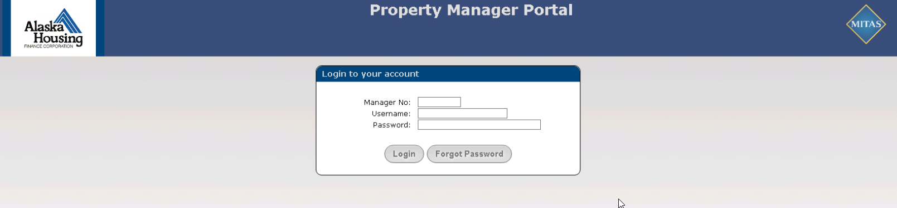
Login
AHFC will be e-mailing each Property Manager main contact their login information. Please select “Forgot Password” to reset your password on your first login.
https://compliance.ahfc.us
Browsers: Chrome, Firefox, Microsoft Edge, (No Internet Explorer)
Update your browsers.

Slide 4
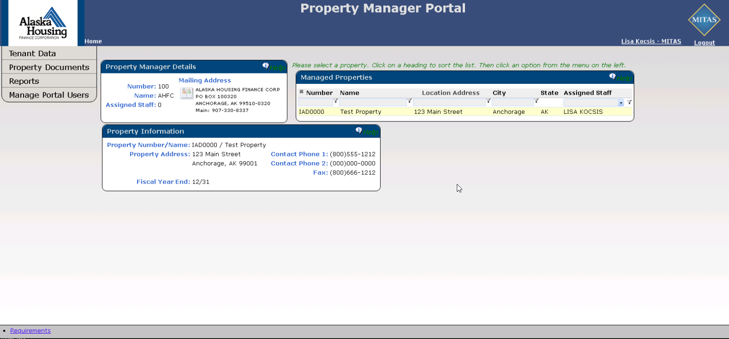
Home Screen
Menu Options:
Tenant Data
Property Documents
Reports
Manage Portal Users
Each Property Manager Company will see a list of their AHFC Properties. Highlight your Property before choosing a menu option.

Slide 5

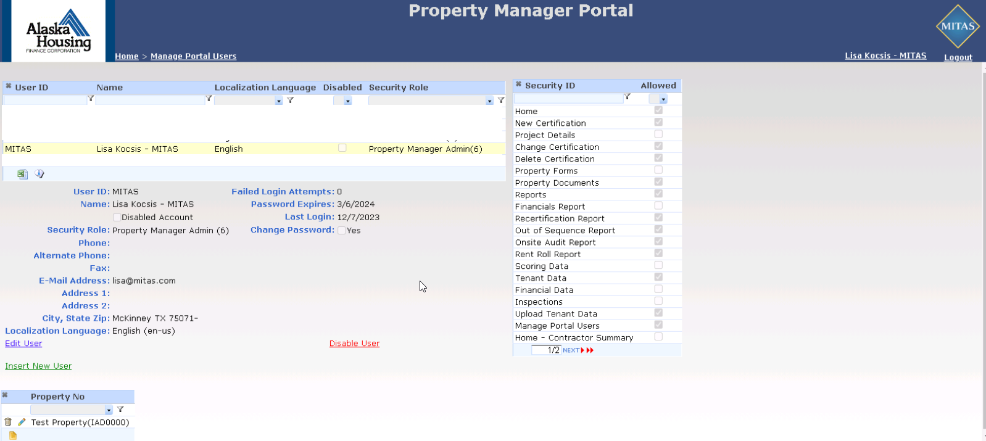
Manage Portal Users
Setup Your Users
“User ID” is the Username on the Login Screen
Enter the Full Name of the User in “Name”
Select a Security Role
Enter Phone Number
Enter E-mail
Assign Properties from the drop-down list.
Click the “Home” screen when you are finished.

Slide 6
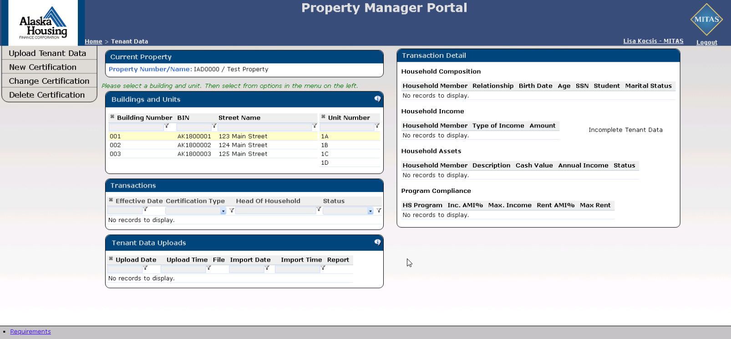
Tenant Data
Upload NAHMA File
If your Property Management software includes an export using a NAHMA format, export your tenant data from your software.
Choose Upload Tenant Data
This screen will display all buildings and unit along with the current certification information.

Slide 7
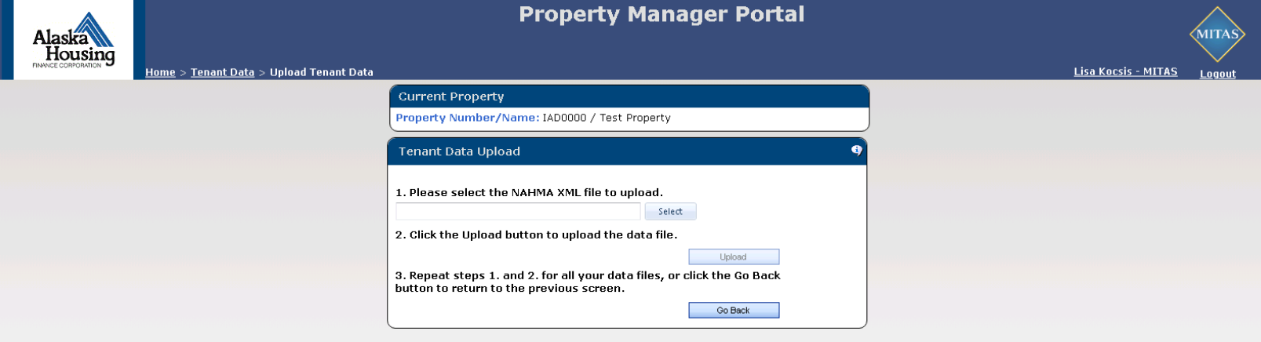
Upload Tenant Data
Upload NAHMA File
AHFC is requesting Tenant Data from the years 2022 and 2023.
You may submit one file or multiple files.
Include the Move In transaction for every tenant during the years 2022 and 2023. If you are not sure how to include the move in information, please contact your software support team.
NOTE: If your software does not contain the Move In certification for your tenant as of 01/01/2022, manually enter this move in on the portal. Then use your NAHMA upload to update the other certifications for 2022, 2023, and going forward.

Slide 8
Tips for Uploading Tenant Data
Enter the AHFC Property Number into your software under Project Number. This number will begin with IAD; example IAD0104.
Name your file upload with the Name of the Property somewhere in your file name.
Always check your Error Report!
You can find your “IAD” number on the Home screen.
Note: MITAS will need to match the Property Number (ProjectID), Building Number (BIN), and the Unit Number in your software in order to upload your NAHMA file.

Slide 9
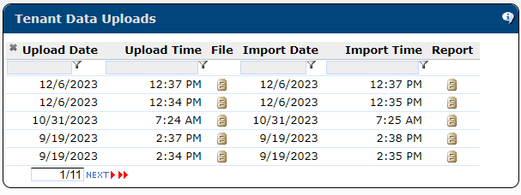
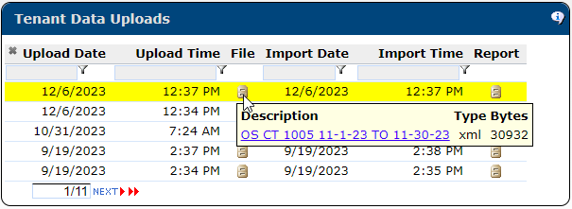
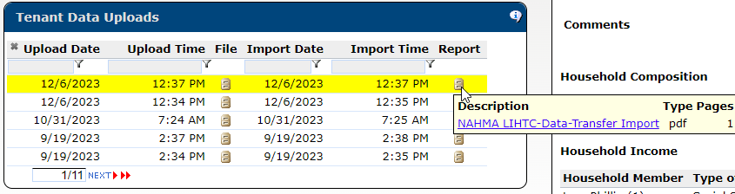
Tenant Data Uploads Information Bubble
Tenant Data Screen
After you upload, this screen will keep track of all the uploaded files.
The “FILE” column is your xml file. Your may access it from here.
The “REPORT” column is your Error Report.
Always check your Error Report!

Slide 10
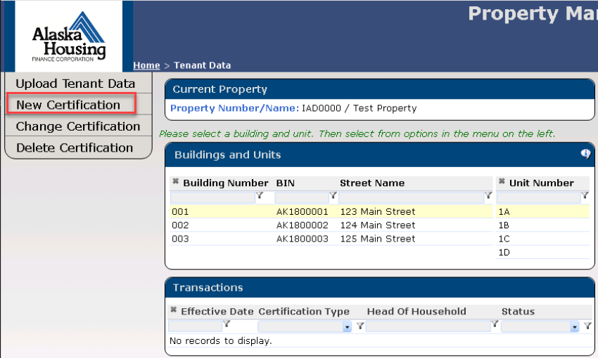
Manually Enter Transactions - New Certification
Enter your tenant transactions
If you do not have Property Management software, you can manually enter the tenant data that you currently send to AHFC in a spreadsheet.

Slide 11
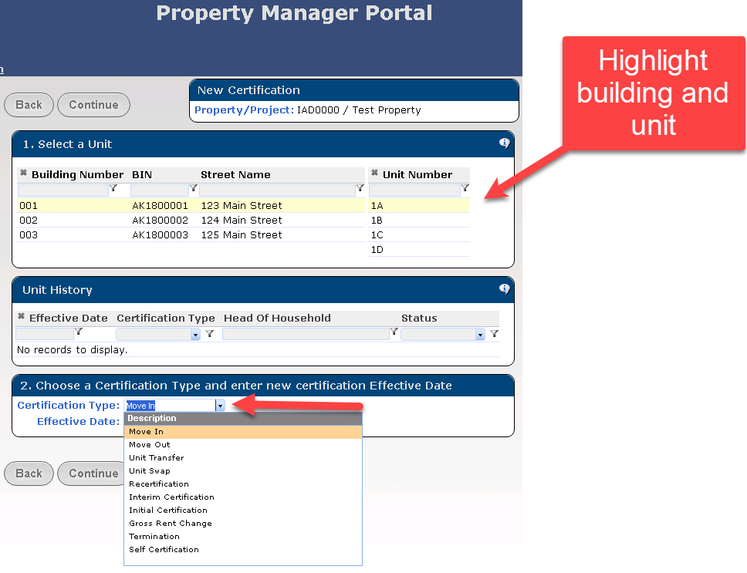
New Certification
Enter a tenant transaction
Select the building and the unit.
Select the type of tenant transaction.

Slide 12
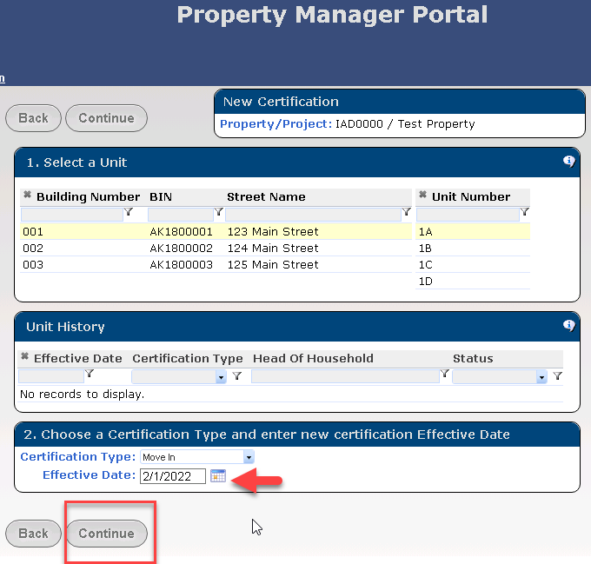
New Certification
Enter the Effective Date of the Transaction.
Press “Continue”

Slide 13
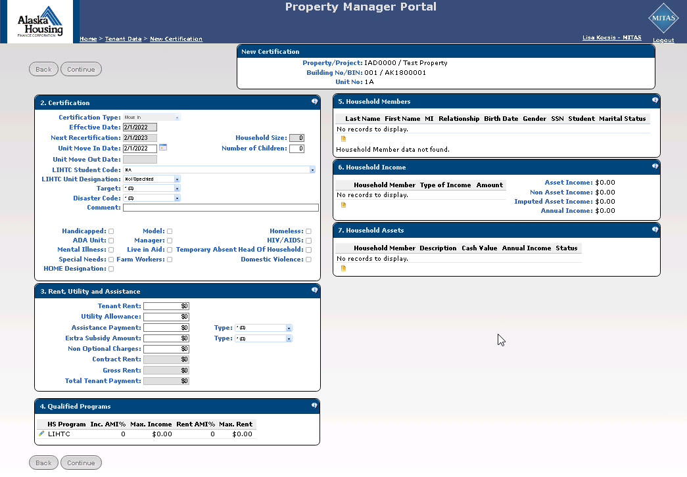
New Certification – Move In

Slide 14
New Certification – Move In
Tips for Entering a Move In Transaction
Fields that are grey will automatically populate when needed
Choose the Unit Designation – Either a Low Income (Affordable Unit) or a Market Unit
Indicate with the checkboxes if the unit or tenant meets any of the designations
Always flag any HOME unit with this checkbox
The first 5 Rent fields allow data entry – the last 3 rent fields will calculate
Always indicate a “type” of assistance when entering Assistance Payments or Extra Subsidy
Qualified Programs Bubble – ALWAYS enter your designation for the set-aside on Affordable Units by using the edit pencil for each program where this tenant meets the set-aside
Include the Max Income and Max Rent – This is the Income Limit and Rent Limit you follow for the set-aside for this tenant.
Insert every Household Member by using the yellow notepad icon
Household Size field will automatically increase which each household member you add
Include Household Income and Assets for each member by using the yellow notepads
Press Continue when done. You may see errors at this point if you did not complete the transaction.

Slide 15
New Certification – Move In – Senior Housing Only Properties
Tips for Entering a Move In Transaction
Choose the Unit Designation – Either a Low Income (Affordable Unit) or a Market Unit
  Choose the Low Income Unit Designation even though your tenants will qualify by their age and not Income or Rent. Choosing “Market” or leaving the field blank will mean they do not qualify for the SCHDF program.
Enter Age or Birthdate. One of these fields is required to qualify your tenant.
Indicate with the checkboxes if the unit meets the ADA designation
You can leave the Rent fields blank. They are not required for this program.
Qualified Programs Bubble – Skip this bubble
Insert every Household Member by using the yellow notepad icon
Household Size field will automatically increase with each household member you add
Skip Household Income and Assets for each member by using the yellow notepads
Press Continue when done. You may see errors at this point if you did not complete the transaction.

Slide 16
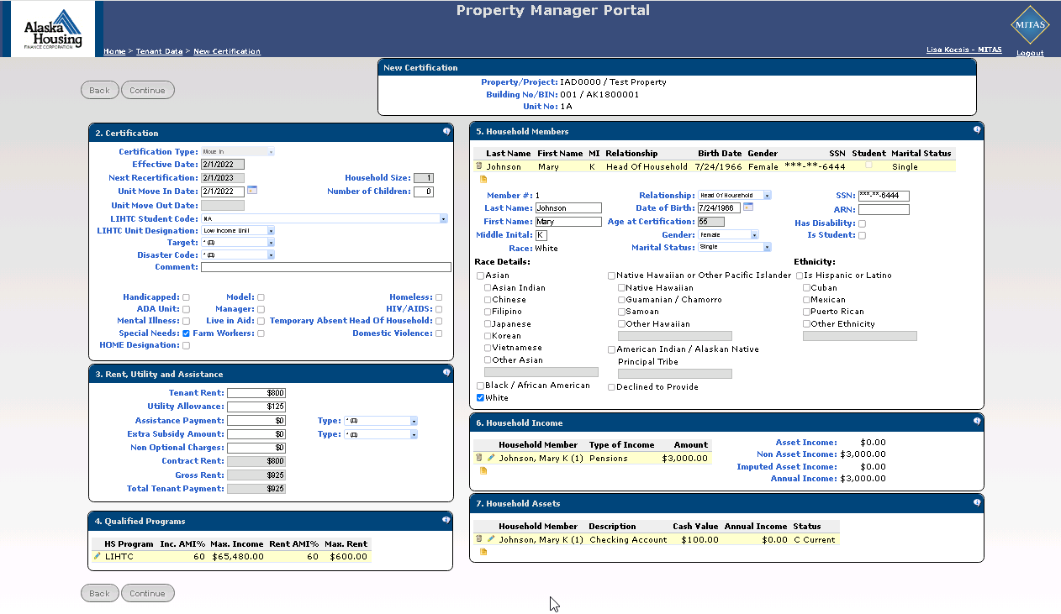
New Certification – Move In – Example with 1 Household Member

Slide 17
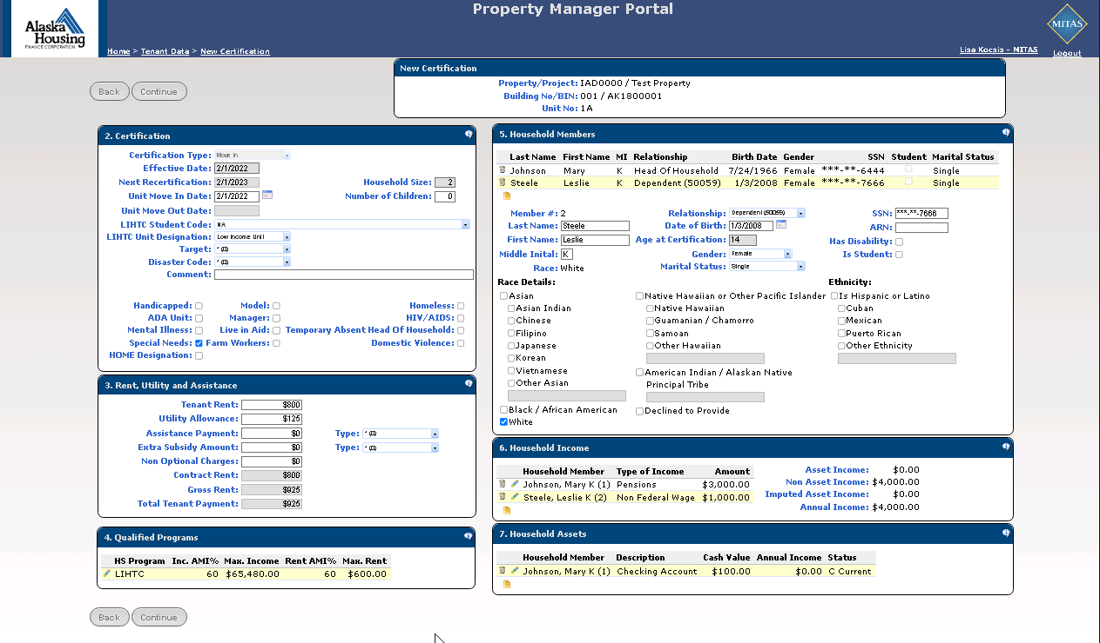
New Certification – Move In – Example with many Household Members

Slide 18
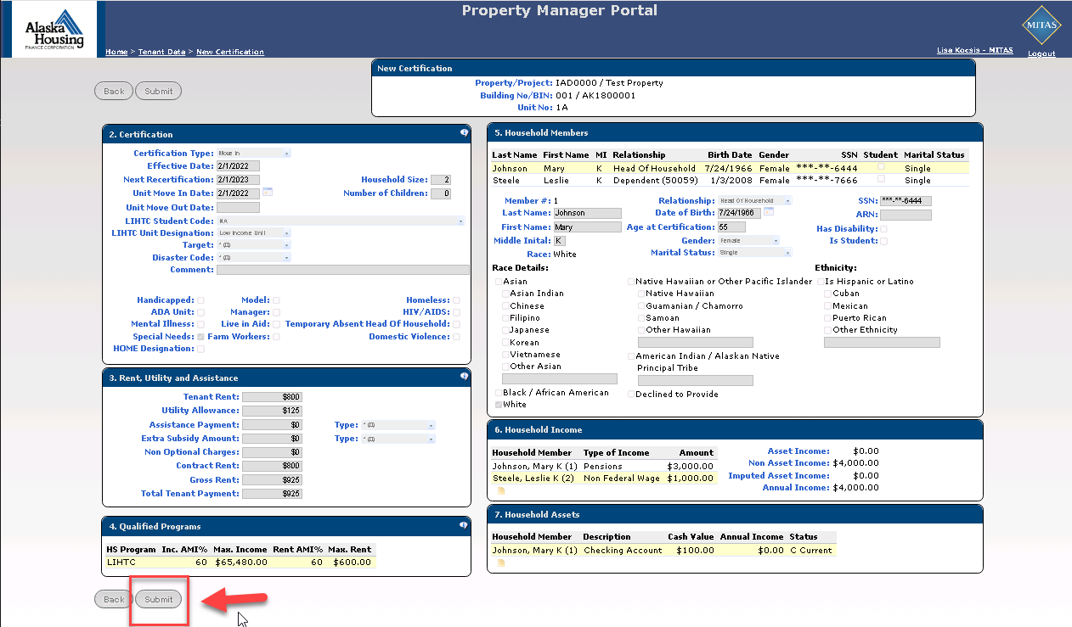
New Certification - SUBMIT

Slide 19
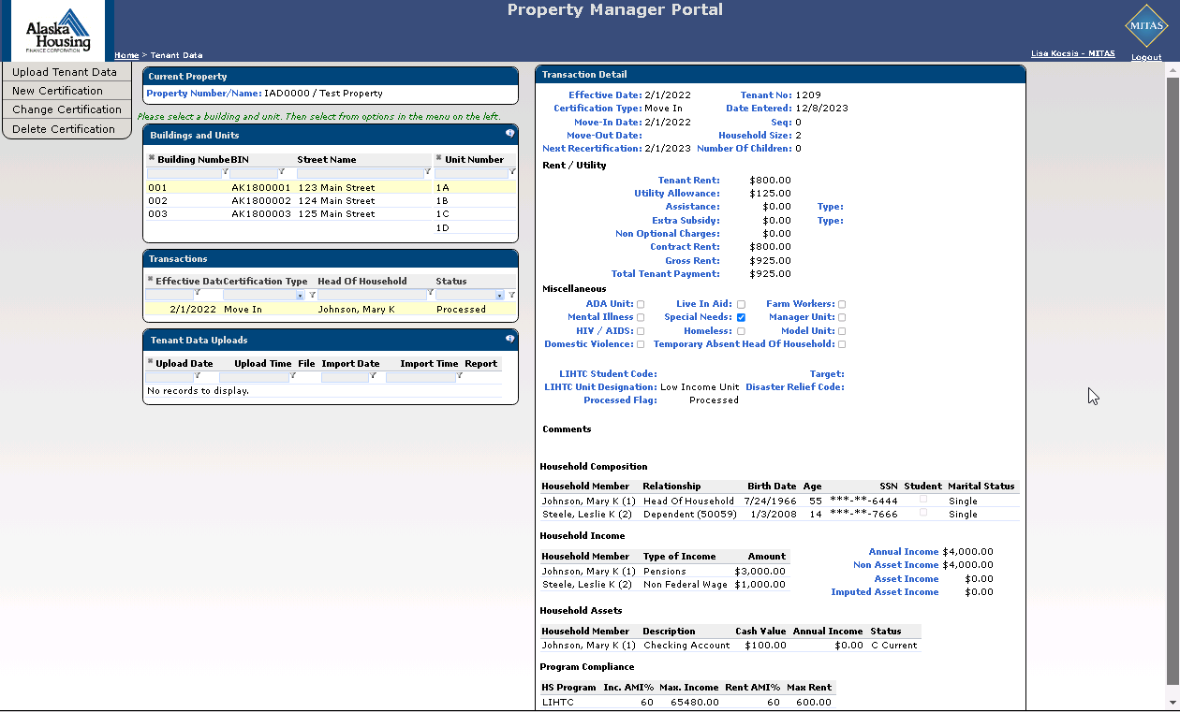
Tenant Data Screen
Portal returns to the Tenant Data Screen.
View Screen to see all data for each certification.
Change Certification will bring back the data entry screens for the highlighted transaction.
Delete Certification will delete the highlighted transaction.

Slide 20
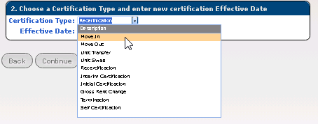
Type of Certifications
Always enter a Move In before any other transaction for each tenant.
Make sure the unit is vacant before entering a Move In. (Enter a Move Out for the previous tenant first.)
Initial Certifications are used for tenants who already live in the unit and are qualifying for the program post move in.
Terminations are only used to end program participation by a tenant. Example: changing a tenant from a Program Unit (affordable) to a Market Unit.

Slide 21
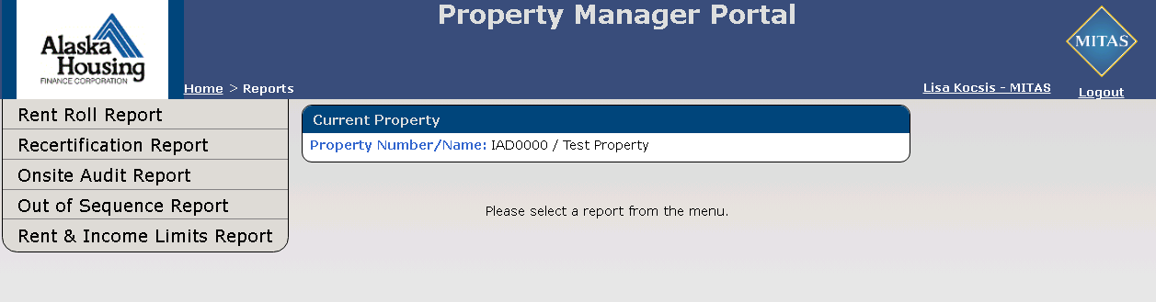
Reports
There are PDF reports available on the portal with excel exports if you wish to retrieve the data in the report with excel.
These reports are also used by the agency to monitor your property.

Slide 22
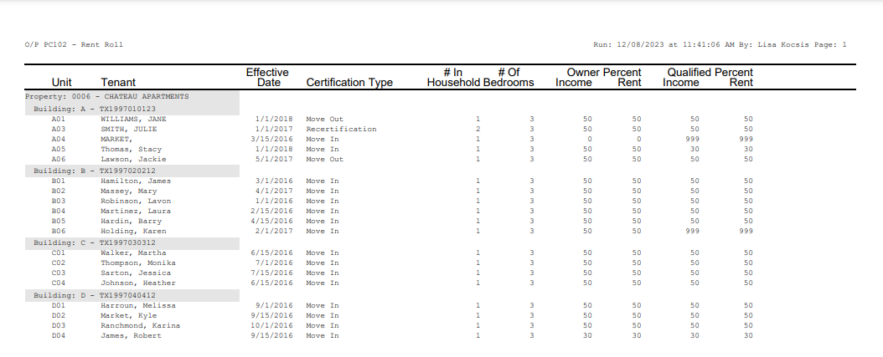
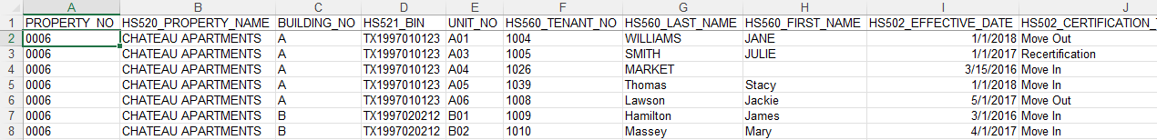
Reports – Rent Roll
Listing of the tenants in each unit at a point in time.
Good for making sure you have completed your data entry for the month.
Also comes with an export to retrieve the tenant data entry into excel. Excel version has more data than the pdf version.

Slide 23
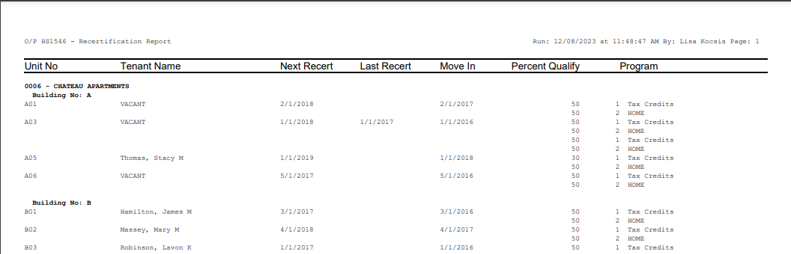
Reports – Recertification Report
Good for keeping track of Recertifications coming due.

Slide 24
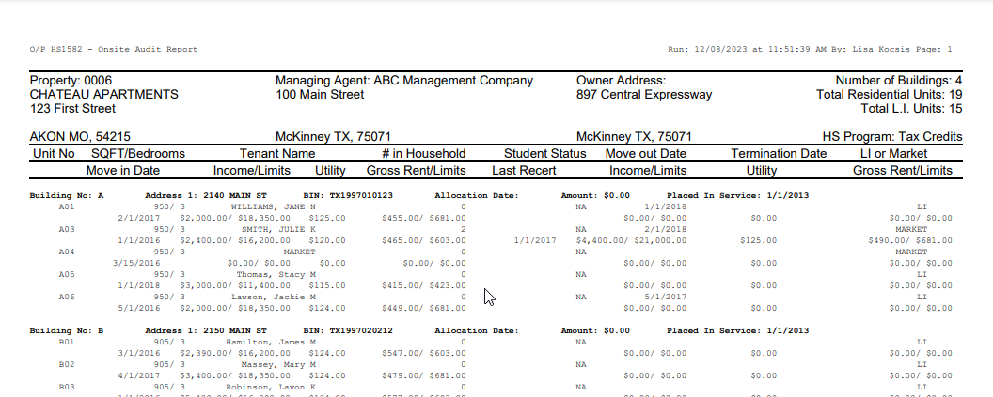
Reports – Onsite Audit Report
Larger report for tracking key elements of compliance monitoring.

Slide 25
Reports – Out of Sequence Report
This report is used to identify when transactions are entered out of order.
For example: A Recertification transaction was entered for a tenant that does not have a Move In transaction.
A tenant is missing their Move Out transaction.
The NAHMA upload will error when transactions are out of order and the transactions will be skipped. It is very important that you always look at your error report when uploading transactions in bulk with the NAHMA file.
When you key transactions manually on the Portal, the system may prevent you from getting your transactions out of order.
This report does its own check to make sure transactions are not missing.

Slide 26
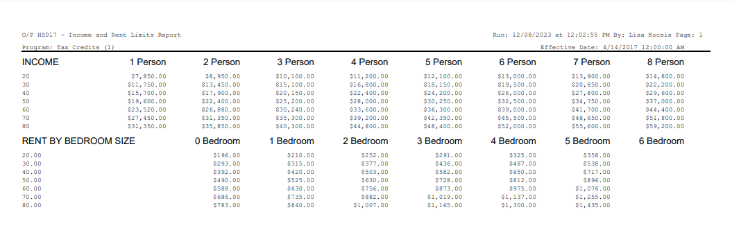
Reports – Rent & Income Limits
This report is specific to a Program (LIHTC, HOME, etc.) and the effective date of limits will print on the top of the report.

Slide 27
Thank you
AHFC Contacts:
Caleb Hite chite@ahfc.us 907-330-8409
Erin Toohey etoohey@ahfc.us 907-330-8408
Walter Webster wwebster@ahfc.us 907-330-8413
Jerusha Gatfield jgatfield@ahfc.us 907-330-8414

